Slide 1

Distributed Transaction
Computer System Engineering, Fall 2019. (IPADS, SJTU)
Transaction across multiple sites
Yubin Xia

Slide 2
Goal: Build Reliable Systems from Unreliable Components
The abstraction that makes that easier is transactions, which provide atomicity and isolation, while not hindering performance
all-or-
nothing
shadow copies (simple, poor performance) or logs (better performance, a bit more complex)
before-or after
2PL (Two-phase locking) ,
or OCC (Optimistic Concurrency Control)
eventually, we also want transaction-based systems to be distributed: to run across multiple machines

Slide 3
multi-site Transaction

Slide 4
Transaction across Multiple Sites
The setup
Client + coordinator + two servers
One server handles A-M
The other server handles N-Z
Coordinator and servers all have logs
Coordinator passes messages from the client to the appropriate server

Slide 5
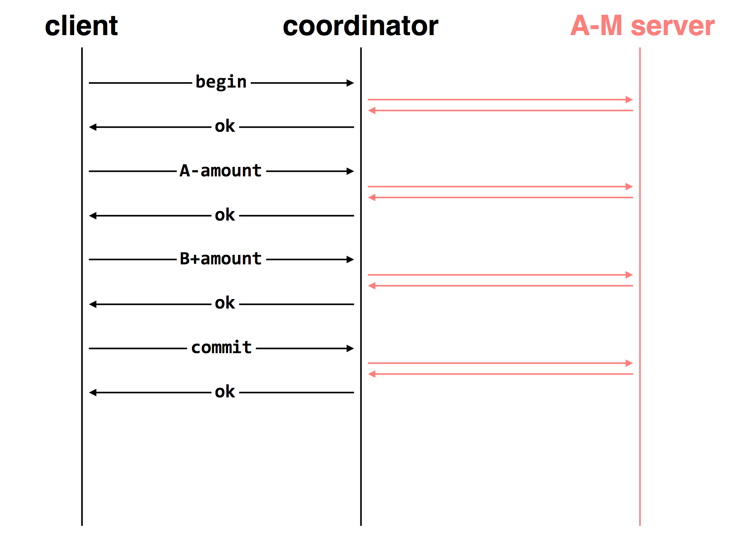

Slide 6
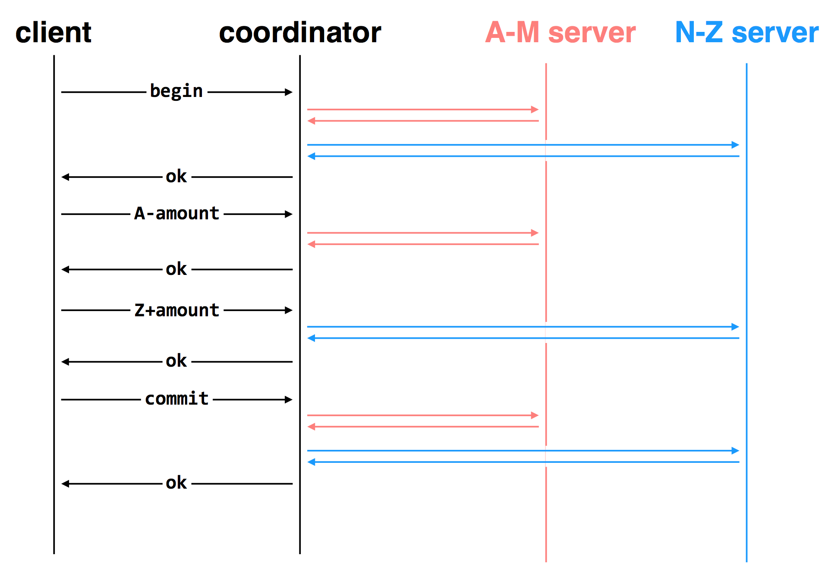

Slide 7
Deal with the Network
Message may be lost, delayed or duplicated
Use RPC to communicate
Ensure at-least-once by persistent sender
Ensure at-most-once by duplicate suppression
However, neither is enough to ensure atomicity here

Slide 8
The Main Problem
Multiple servers can experience different events
One commits while the other crashes, or
One commits while the other aborts, etc.

Slide 9
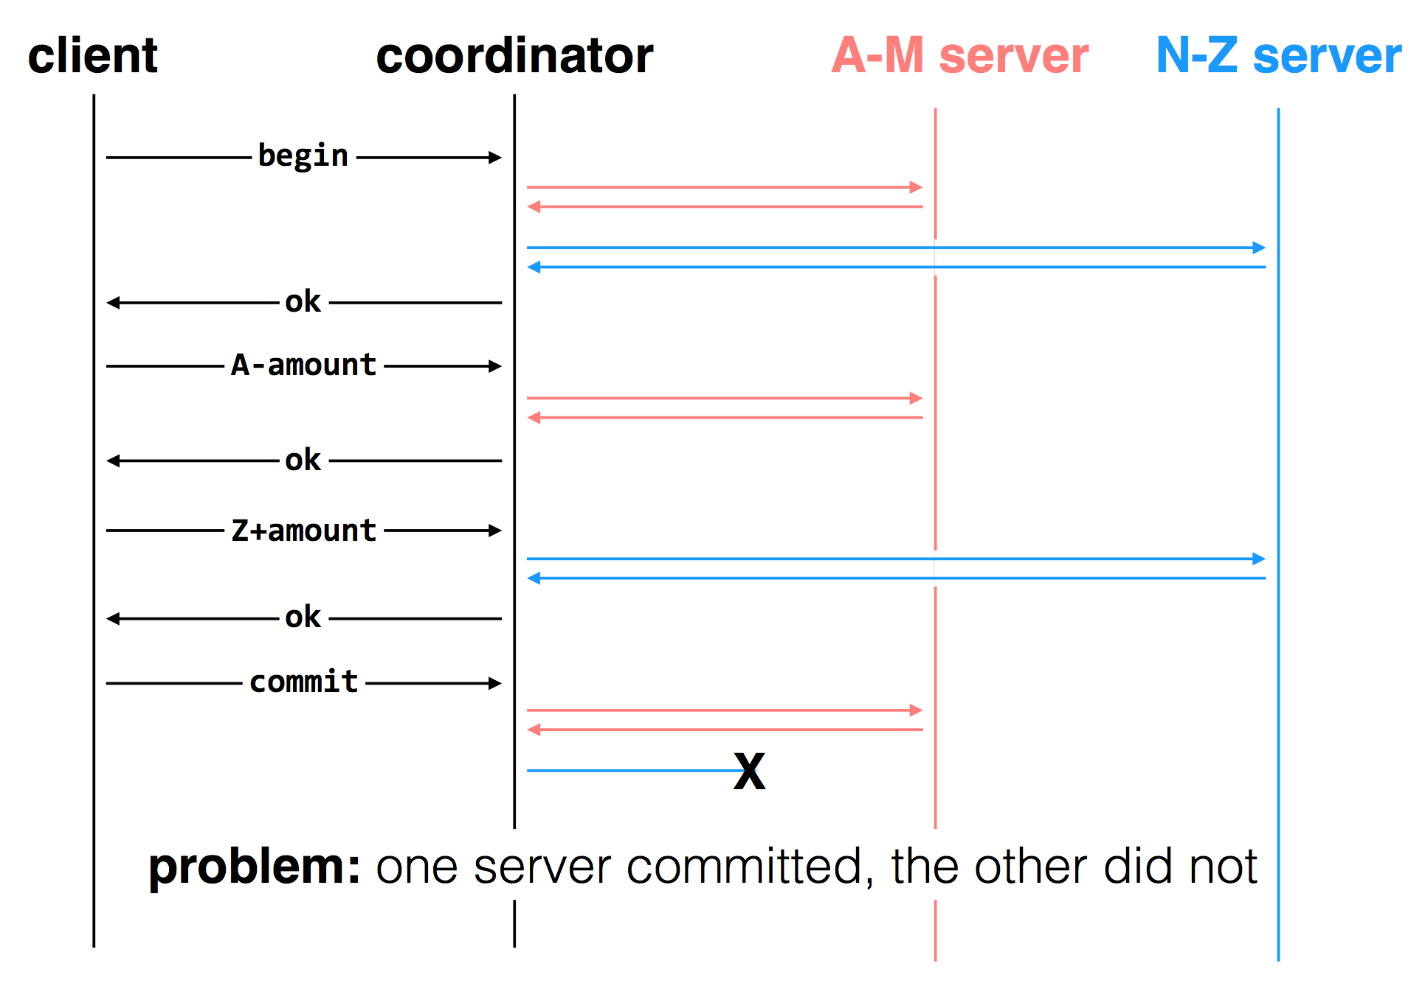

Slide 10
Two-phase Commit
Phase-1: preparation / voting
Lower-layer transactions either aborts or tentatively committed
Higher-layer transaction evaluate lower situation
Phase-2: commitment
If top-layer, then COMMIT or ABORT
If nested itself, then become tentatively committed

Slide 11
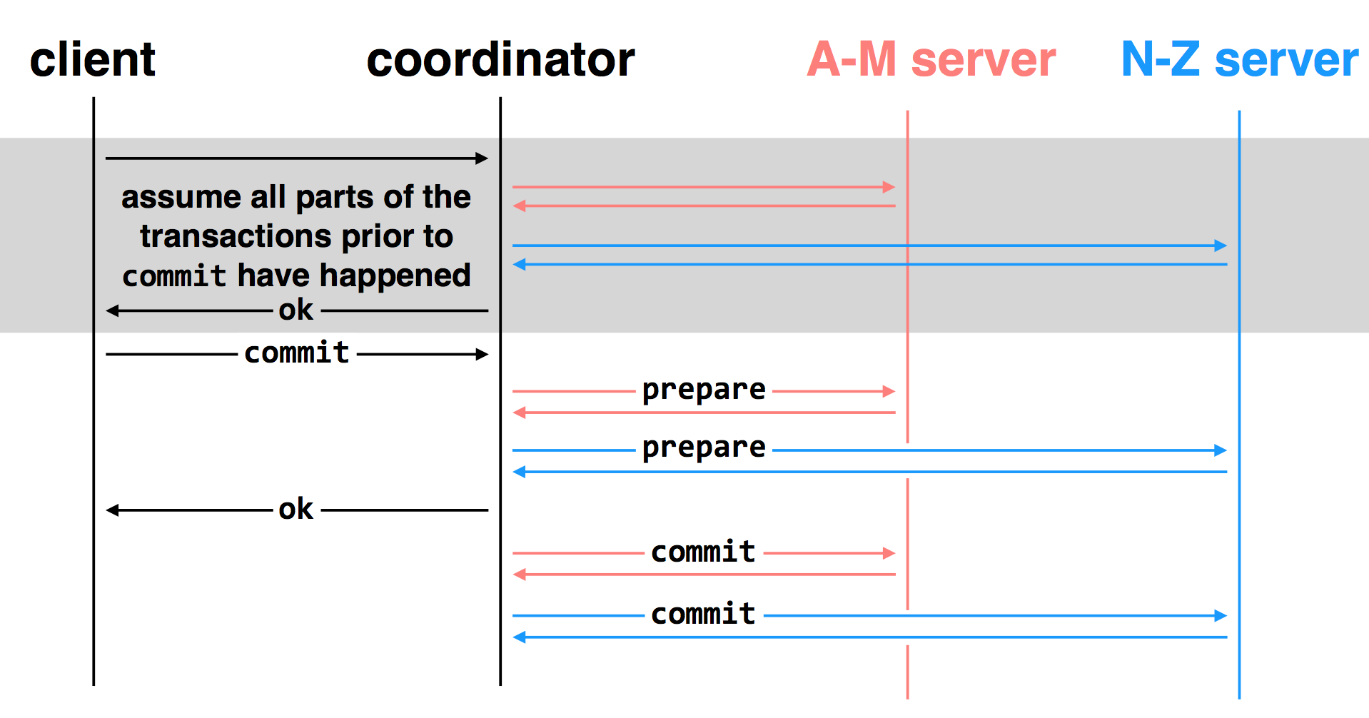
two-phase commit: nodes agree that they are ready to commit before committing

Slide 12
Multiple-site Atomicity
Worker: Bob, Charles, Dawn
Does three transactions: X, Y, Z
Coordinator: Alice
Create a higher-layer transaction
Send three messages to the three workers
Challenge: un-reliable communication

Slide 13
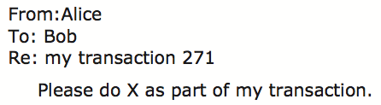
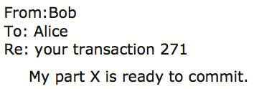
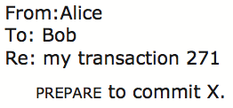
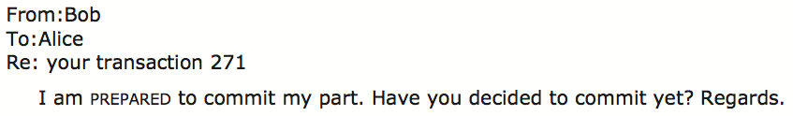
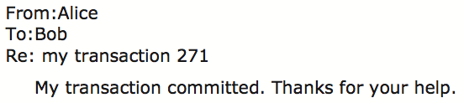
Commit Phase-1
Bob: tentative committed
State: PREPARED
Commit Phase-2
Bob: COMMITTED
Bob will perform post-commit
Notes:
When Bob is PREPARED, what if Alice crash? Bob may wait indefinitely. Here, the coordinator is a single point of failure.
Alice collects PREPARED responses.
After "thanks" from Alice, B,C,D will change from PREPARED to COMMITTED, perform post-commit actions and exit.

Slide 14
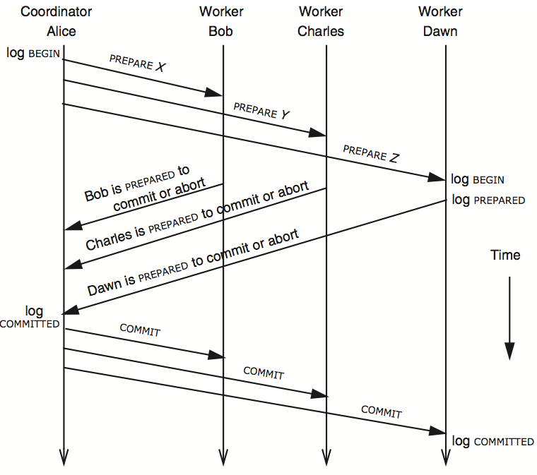
3N messages

Slide 15
Multiple-site Atomicity
Coordinator
Collect some ABORT or nothing: ABORT or assign the work to another worker
Collect all COMMIT: then COMMIT
Worker
When receive nothing: resend PREPARED
Coordinator will send current state if it receives duplicate message
When receive COMMIT: then COMMIT

Slide 16
client
coordinator
A-M server
N-Z server
assume all parts of the transactions prior to
commit have happened
OK
commit
prepare
prepare
OK
commit
commit
two-phase commit: nodes agree that they're ready to commit before committing

Slide 17
client
coordinator
A-M server
N-Z server
OK
commit
X
prepare
timeout; resend
prepare
prepare
OK
commit
commit
failure: lost prepare

Slide 18
client
coordinator
A-M server
N-Z server
OK
commit
prepare
X
timeout; resend
prepare
prepare
OK
failure: lost ACK for prepare

Slide 19

client
coordinator
A-M server
N-Z server
OK
commit
prepare
prepare
abort
abort
failure: worker failure during prepare

Slide 20
client
coordinator
A-M server
N-Z server
OK
commit
prepare
prepare
OK
commit
X
Why? Just wait..
tx?
timeout; resend
commit
commit
failure: lost commit message

Slide 21
client
coordinator
A-M server
N-Z server
OK
commit
prepare
prepare
OK
commit
X
timeout; resend
commit
commit
failure: lost ACK of commit message

Slide 22

client
coordinator
A-M server
N-Z server
OK
commit
prepare
prepare
OK
commit
commit
failure: worker failure during commit

Slide 23
Worker Failure During Commit
If workers fail after the commit point
We cannot abort the transaction
Workers must be able to recover into a prepared state
Workers write PREPARE records to log once prepared
The recovery process will:
Read through the log, and
Indicate which transactions are prepared but not committed

Slide 24

client
coordinator
A-M server
N-Z server
OK
commit
prepare
prepare
OK
commit
commit
tx?
restart
commit
failure: worker failure during commit

Slide 25

client
coordinator
A-M server
N-Z server
OK
commit
prepare
coordinator recovers
abort
abort
failure: coordinator failure during prepare

Slide 26
client
coordinator
A-M server
N-Z server
OK
commit
prepare
prepare
OK
commit
coordinator recovers
commit
commit
failure: coordinator failure during commit

Slide 27
Summary of 2-phase Commit
Two-phase commit allows us to achieve multi-site atomicity: transaction remains atomic even when they require communication with multiple machines
In two-phase commit, failures prior to the commit point can be aborted. If workers (or the coordinator) fail after the commit point, they recover into the PREPARED state, and complete the transaction
Our remaining issue deals with availability and replication: we will replicate data across sites to improve availability, but must deal with keeping multiple copies of the data consistent

